Slide 1

Predicting ICU Patient Deterioration and Mapping Their Trajectories
Alex Nite
Capstone project

Slide 2

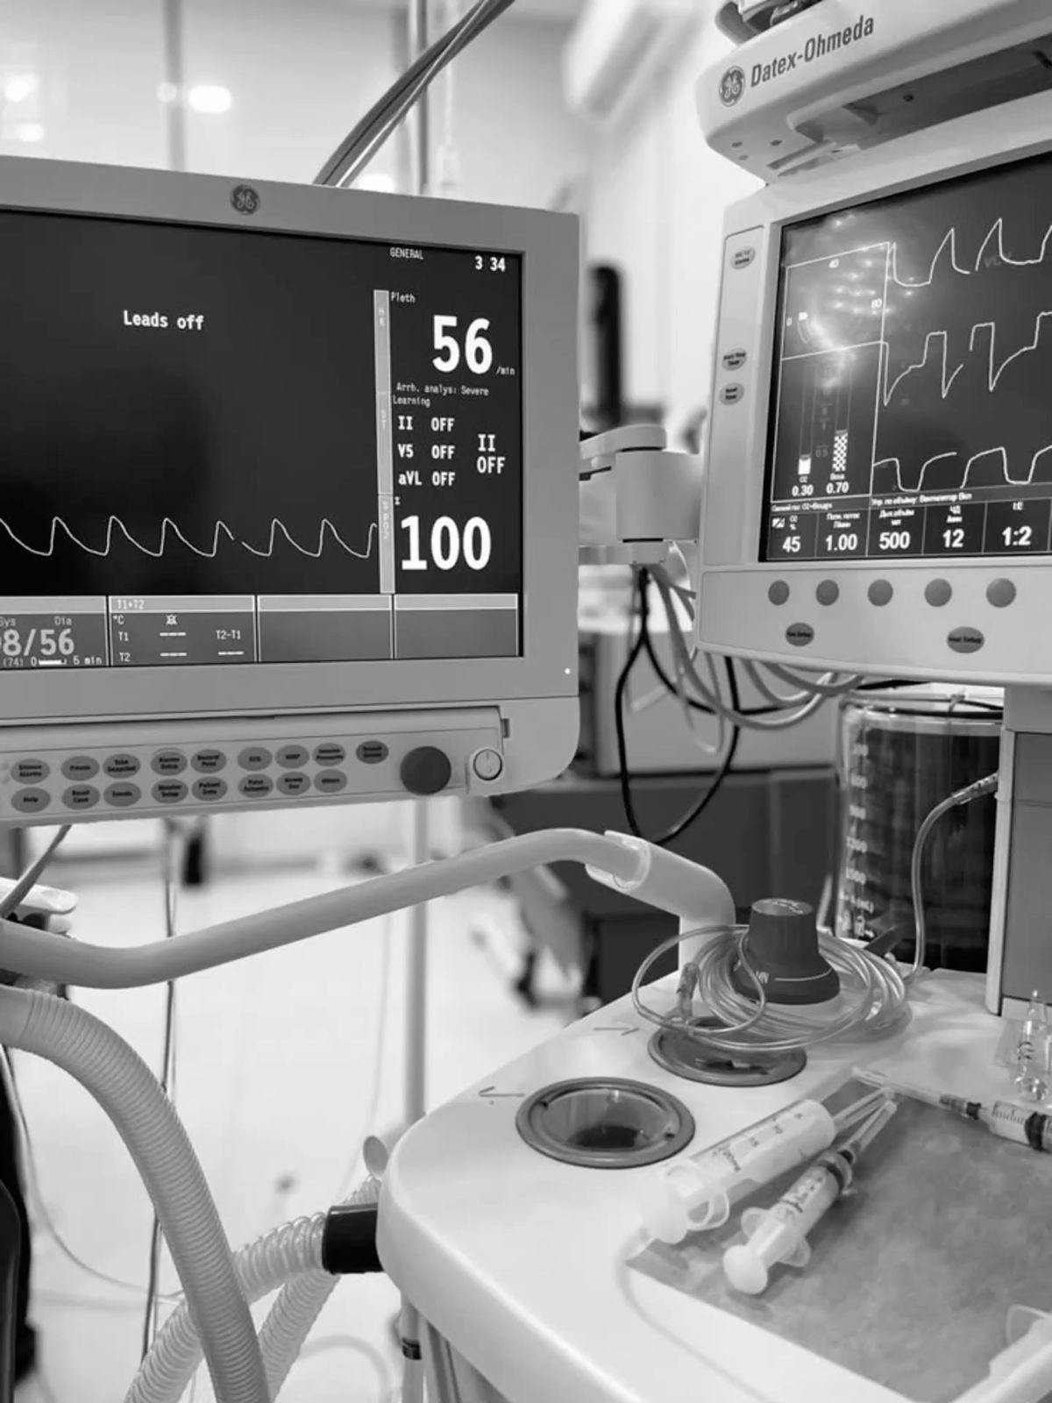

Why ICU Deterioration Prediction Matters
ICU patients can deteriorate rapidly
Early warning signs are subtle, nonlinear, and easily missed
Traditional scoring systems (e.g., APACHE) capture severity but not dynamics
Machine learning can detect complex, multi‑system interactions

Slide 3
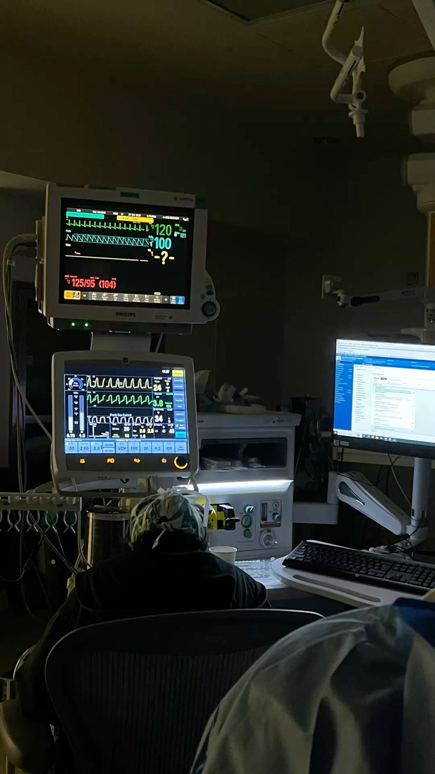
Central Research Question
Central Question
Can time‑series physiological data + demographic + severity metrics accurately predict ICU deterioration and reveal meaningful trajectory patterns?

Slide 4

What Prior Work Missed
Small feature sets (mostly vital signs)
Limited temporal modeling
No clustering of patient trajectories
Single‑center datasets → limited generalizability

Slide 5

Dataset Overview
eICU Collaborative Research Database
Multi‑hospital ICU dataset
Demographics
Vital signs (periodic + aperiodic)
Labs
Medications
APACHE severity scores
Mortality outcomes

Slide 6
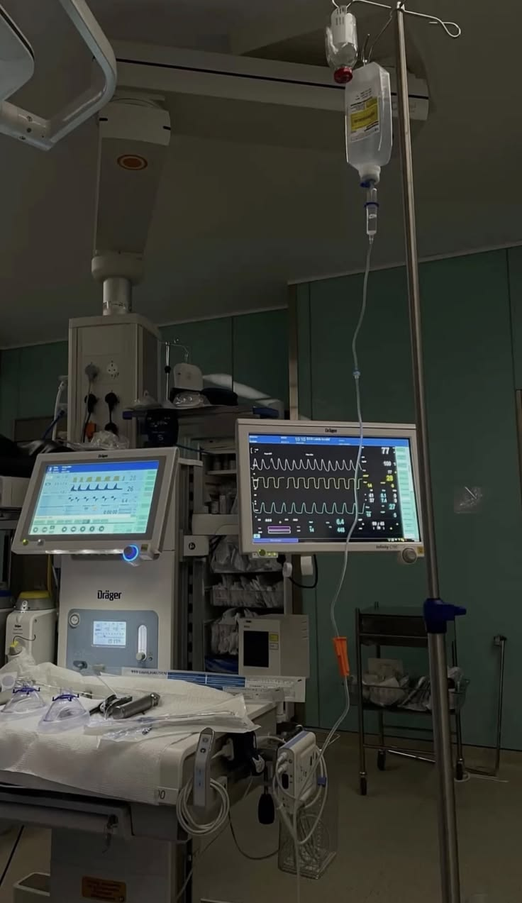
Data Preprocessing
Standardized age, imputed missing values
Cleaned labs, medications, diagnoses
Forward/backward filled time‑series vitals
Merged all datasets into patient‑level features

Slide 7
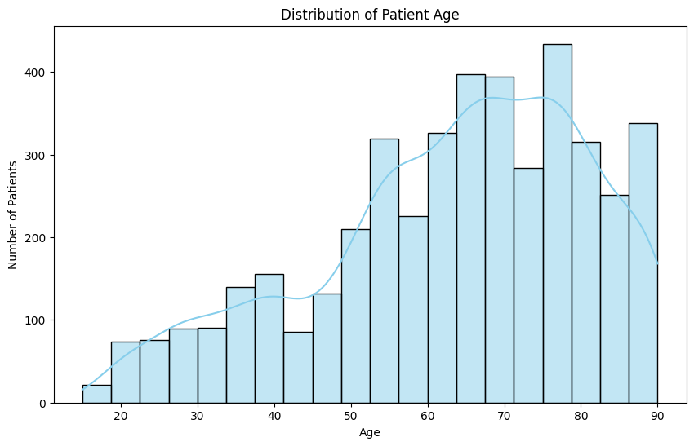
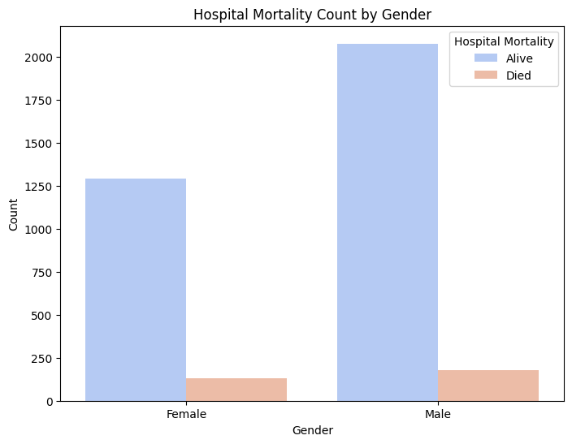
Exploratory Data Analysis
Key EDA Findings
Mortality similar across genders
Age skewed older

Slide 8
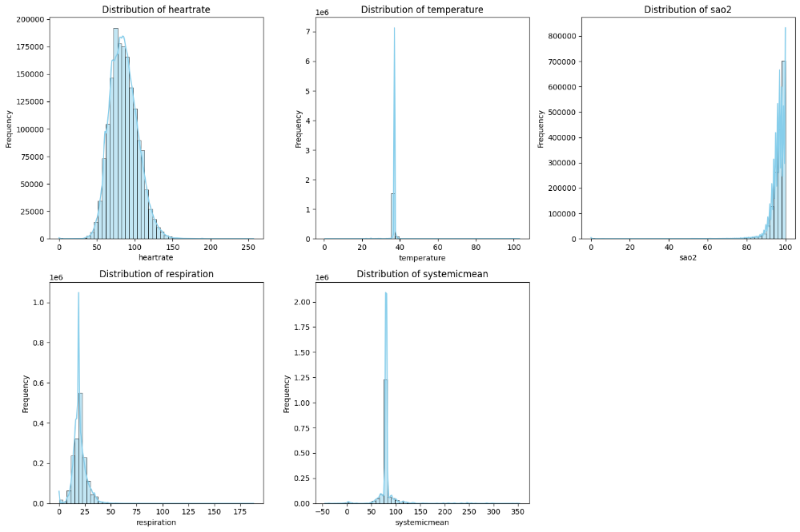
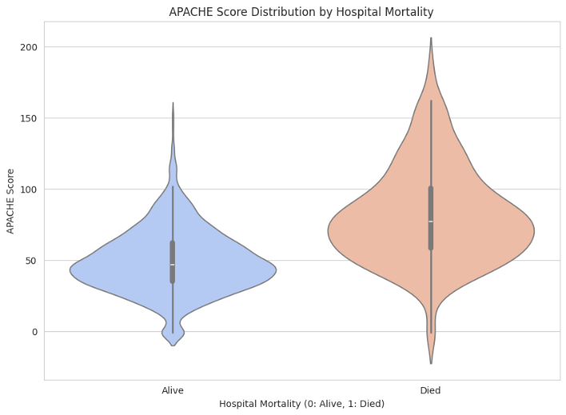
Exploratory Data Analysis
Key EDA Findings
APACHE strongly correlated with mortality
Vital signs show expected ranges + extreme values

Slide 9
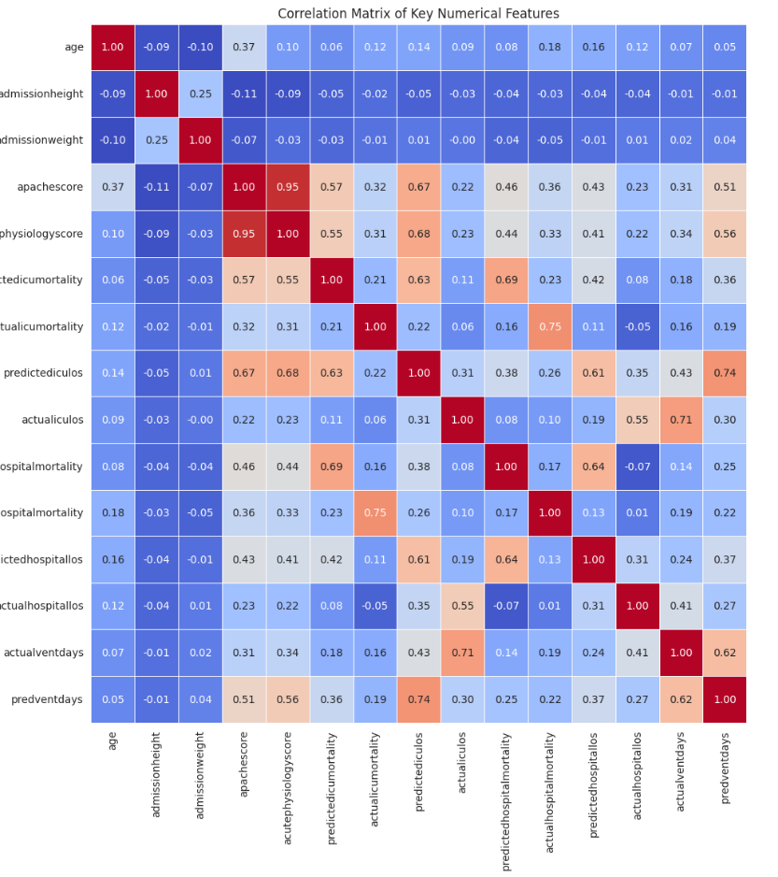
Exploratory Data Analysis
APACHE & acute physiology scores strongly correlate with mortality
Ventilation days correlate with severity
LOS correlates with predicted LOS
Height/weight show weak correlations

Slide 10
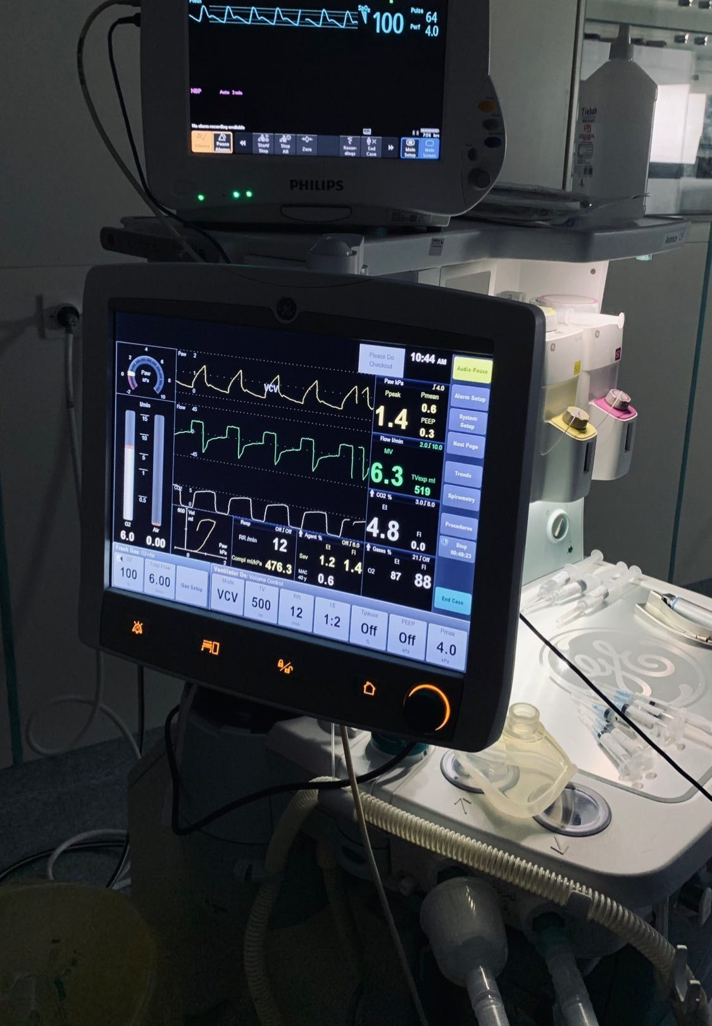
Time‑Series Feature Engineering
First 24 hours summarized
Means, mins, maxes, SDs for vitals
Lab summaries
Medication counts + dosages
Diagnosis/treatment counts
One‑hot encoding for categorical variables

Slide 11
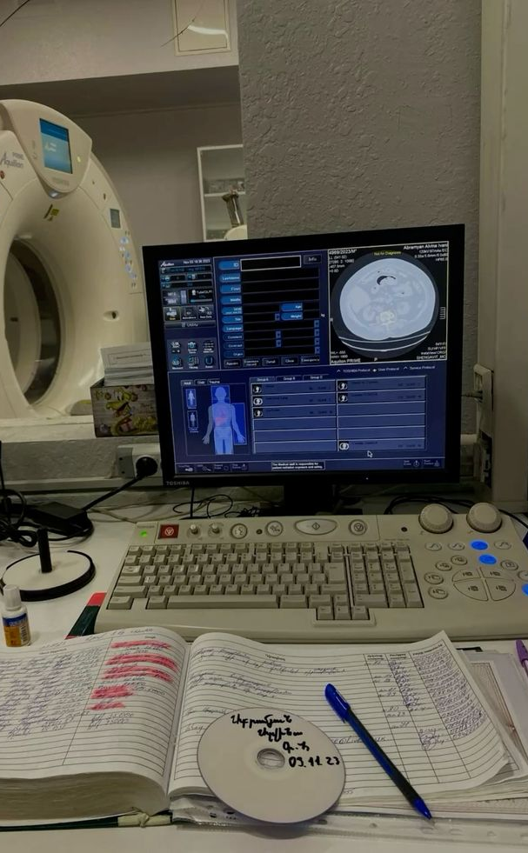
PCA Dimensionality Reduction Results
884 → 427 components (95% variance)
PC1 = global physiological stability
PC4 = respiratory function
PC2/PC3 = renal + inflammatory patterns

Slide 12

Supervised Learning Overview
Models Evaluated
Logistic Regression
Random Forest
LightGBM
XGBoost
KNN
Why This Set?
Covers linear → nonlinear → boosting paradigms
Allows comparison of interpretability vs. performance
Handles class imbalance differently

Slide 13
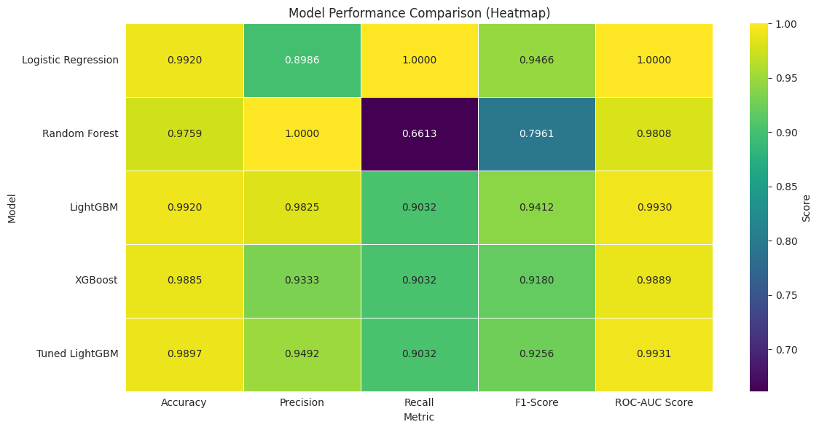
Supervised Learning Overview
Logistic Regression: perfect recall, lower precision
Random Forest: perfect precision, low recall
LightGBM: best balance across all metrics
XGBoost: strong but slightly lower precision
KNN: weakest due to high‑dimensional space

Slide 14
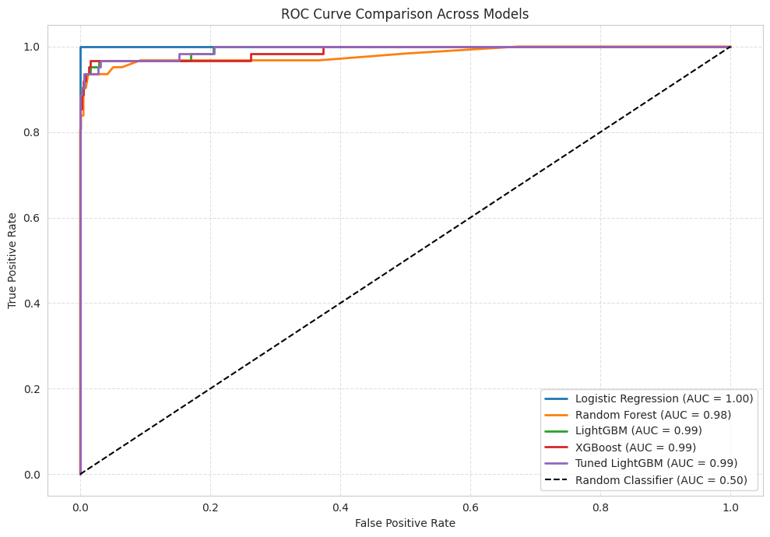
ROC Curve Interpretation
LightGBM: AUC = 0.9930 → near‑perfect discrimination
XGBoost: AUC = 0.9889 → extremely strong performance
Logistic Regression: AUC = 1.0000 → perfect separation on this dataset
Random Forest: AUC = 0.9808 → strong but noticeably less sensitive at lower thresholds
KNN: AUC = 0.7961 → poor discrimination compared to all other model

Slide 15
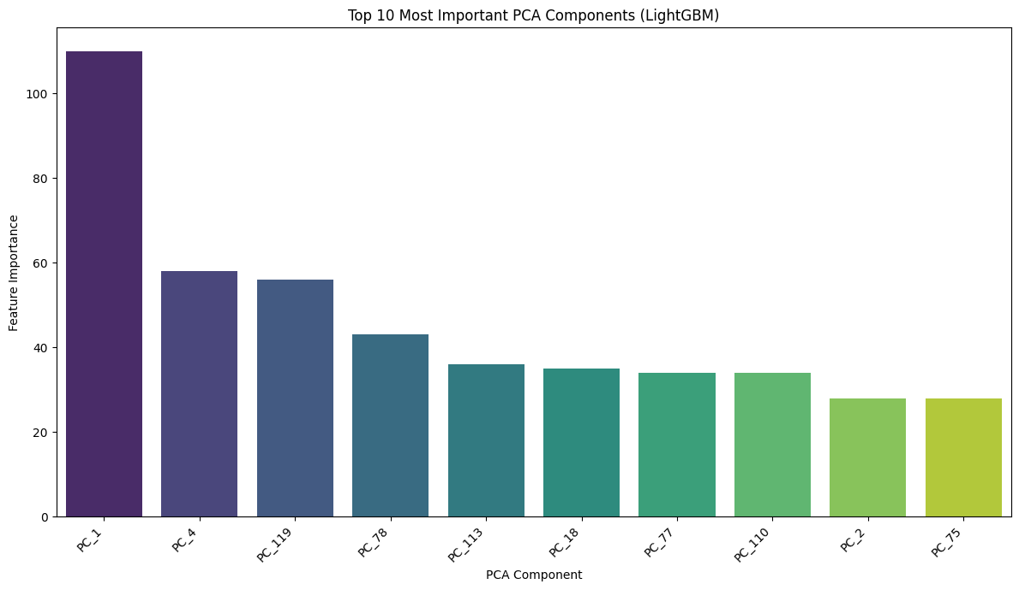
Top 10 PCA Components (LightGBM Importance)
PC1 contributes ~40–45% of total model importance → Dominant predictor capturing global physiological stability
PC4 contributes ~10–12% → Strong respiratory component (paCO₂, RBC‑related oxygen transport)
PC119 contributes ~6–8% → Captures nuanced trajectory patterns (respiratory variability, CO₂ dynamics, discharge‑related variables)
Remaining top components (PC18, PC75, PC78, PC118, etc.) each contribute 2–4% → Smaller but meaningful signals related to renal function, inflammation, and hemodynamics

Slide 16

Unsupervised Modelling
K-Means Clustering
Hierarchical Clustering

Slide 17
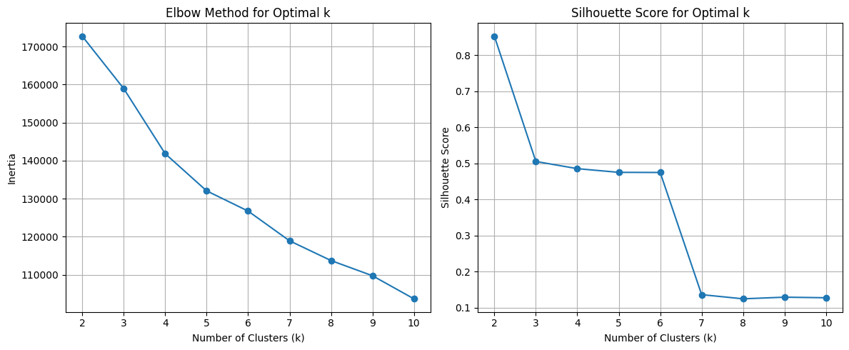
K‑Means Clustering
Optimal k = 2
Silhouette Score peaks at 0.85 → strong separation for k = 2
Elbow Method shows diminishing returns after k = 2

Slide 18
K‑Means Clustering
Cluster Sizes:
Cluster 0: 2,367 patients (99.66%)
Cluster 1: 8 patients (0.34%) → extreme imbalance
Vital Sign Differences (Means):
Respiration Rate: 21.52 (Cluster 1) vs 19.57 (Cluster 0)
CVP: 11.72 (Cluster 1) vs 16.11 (Cluster 0)
SpO₂: 96.92% (Cluster 1) vs 95.96% (Cluster 0)
Interpretation:
Cluster 1 shows higher respiratory drive + lower venous pressure
Suggests a physiologically distinct but rare subgroup
Metric | Cluster 0 | Cluster 1
Number of Patients | 2367 | 8
Heart Rate (mean) | 83.78 | 79.27
Temperature (mean) | 37.15 | 37.12
Oxygen Saturation (SpO₂ mean) | 95.96 | 96.92
Respiration Rate (mean) | 19.57 | 21.52
CVP (mean) | 16.11 | 11.72
End-tidal CO₂ (mean) | 29.91 | 30.00
Systemic Systolic BP (mean) | 122.73 | 123.21
Systemic Diastolic BP (mean) | 61.39 | 60.07
Systemic Mean BP (mean) | 80.65 | 79.32
PA Mean Pressure (mean) | 25.15 | 23.84
ICP (mean) | 11.03 | 11.00

Slide 19
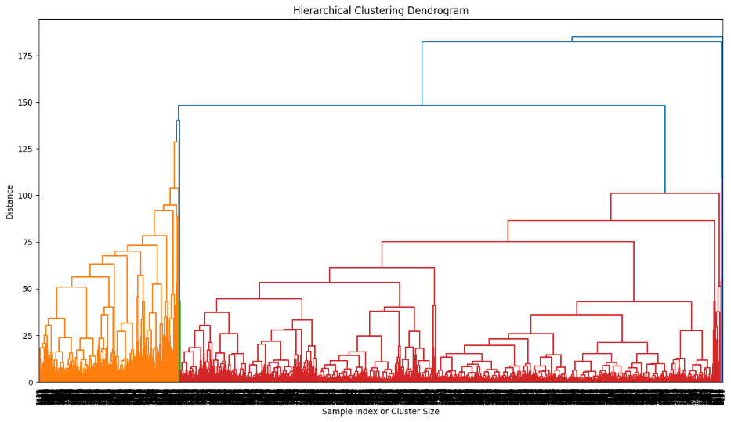
Hierarchical Clustering
Three distinct clusters emerged using Ward’s method
Cluster Sizes:
Cluster 1: 1,102 patients (~46%)
Cluster 2: 842 patients (~35%)
Cluster 3: 456 patients (~19%)
Mortality Rates:
Cluster 1: ~20% mortality → highest‑risk group
Cluster 2: ~9% mortality → intermediate severity
Cluster 3: 0% mortality → lowest‑risk, physiologically stable

Slide 20
Hierarchical clustering
Physiological Patterns:
Cluster 1: elevated APACHE, high variability in vitals, more ventilation days
Cluster 2: moderate severity, moderate variability
Cluster 3: stable vitals, lower APACHE, minimal respiratory instability
Interpretation
Hierarchical clustering captures nested severity gradients that K‑Means missed
Clusters map onto clinically meaningful phenotypes
Suggests ICU patients follow distinct physiological trajectories rather than a single deterioration pathway

Slide 21
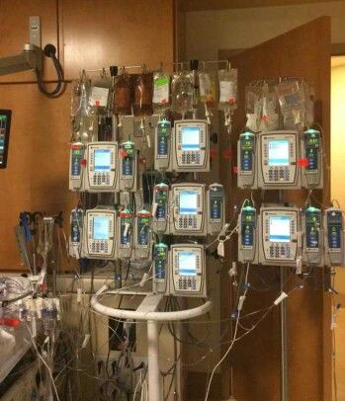
Clinical Implications
Early identification of high‑risk patients
LightGBM achieves >0.99 AUC, enabling reliable early risk stratification
PC1 and PC4 capture global severity + respiratory instability within the first 24 hours
Supports proactive interventions
High‑risk patients could receive earlier respiratory support, fluid management, or closer monitoring
Reduces time‑to‑intervention during deterioration windows
Improves resource allocation
Helps prioritize ICU beds, ventilators, and staffing for patients with the highest predicted risk
Clusters reveal distinct physiological trajectories, enabling tailored monitoring intensity
Enhances clinical decision support
Models can augment—not replace—clinical judgment
Provides continuous, data‑driven risk estimates rather than static APACHE snapshot

Slide 22
limitations
PCA reduces interpretability
Clustering imbalance
No deep temporal modeling
No external validation
Potential dataset bias

Slide 23
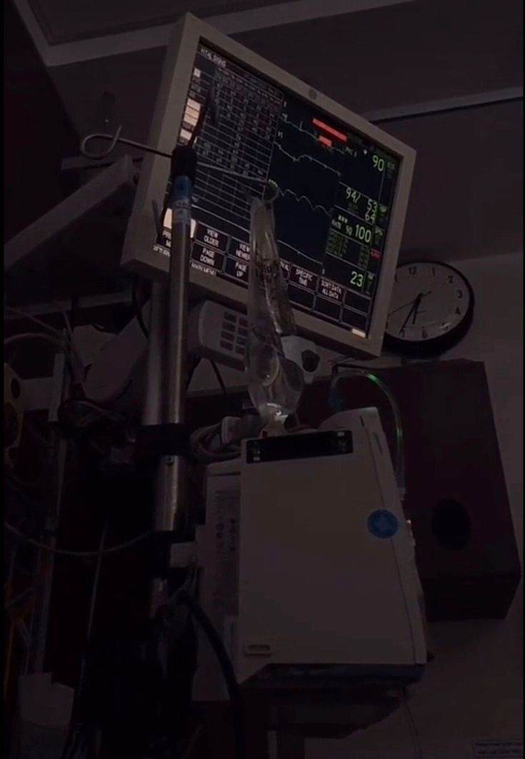
Future directions
Integrate deep temporal models
Improve interpretability of PCA‑based models
Refine clustering with advanced methods
Enhance feature engineering

Slide 24
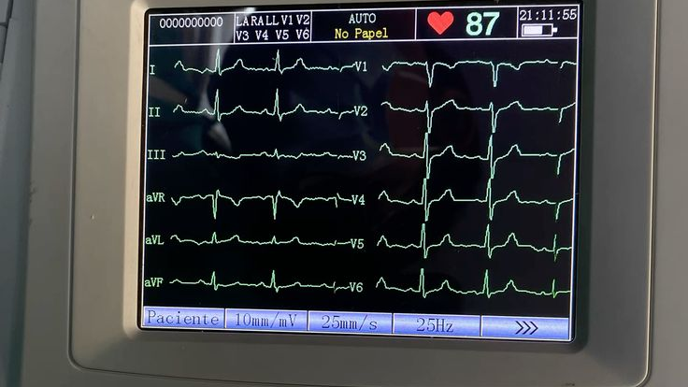
Thank you

